Slide 1
May 11
Preparing the investigation
Calorie Counter
Take good notes
Follow directions
Grades: DW (10%) for notes/packet
‘Test’ (90%) for CER

Slide 2
Calorie Counter
Investigation

Slide 3
On the Handout
Write your name and period

Slide 4
Pre-Investigation
Where do animal get their energy from?
What do animals do to get the energy?
What happens to animals when they digest their food?

Slide 5
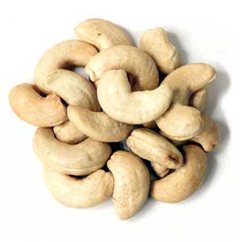
Question
How many calories are in a cashew?

Slide 6
Relevance
People need energy to function.
Understanding how energy is stored will help to better understand food labels and how our bodies use food.

Slide 7
Variables
There are no variables, therefore this is a scientific
O _ _ _ _ _ _ _ _ _ _
Observation

Slide 8
Material
List everything your group uses for this activity (at least 10 items)

Slide 9
Safety
List at least two important safety measures:
1. Tie hair back
2. Use goggles
3. Use caution when working with open flames

Slide 10
Procedure
Read the directions
Watch set- up video

Slide 11
May 15
Complete Do3 handout
Graph and analyze the data
Write a conclusion in CER format
include a rebuttal
(what could have gone wrong? Is there any reason the data could not be 100% reliable?)
Handout is due FRIDAY, latest

Slide 12
Graph
What graph would be best?
Label the axis including the unit used
Title the graph
Use graph paper!

Slide 13
Temperature Change of Water While Burning …………..

Slide 15
Calculation
Use the data in the provided formula
Attention: Temperature DIFFERENCE is used to calculate

Slide 16
CERR
Claim: ……………………. Contains energy.
Evidence: Data (Temperature., Calories)
Reasoning: Explain data, words to use: energy, energy trasnfer, heat, chemical energy
Rebuttal:

Slide 17
Rebuttal
A rebuttal provides reasons for different data or outliers in the data.
Can also provide relevance to real world uses or findings.
What does this mean?

Slide 18
Reasons for different data
Food item did not burn all the way (energy is left in the food and did not make it into the water)
Water was not replaced after one food item. This means the temperature difference used to calculate the calories for the next item is smaller than it should have been.
Air motion in the room put out the fire too soon

